Slide 1
Training Anti-Spam Models with Smaller Training Set Via SVM Way
二資工三 鄧鵬宇 A10515003

Slide 2
互聯網的時代

Slide 3
垃圾郵件的困擾
Every coin has two sides.

Slide 4
The Double-undersampling solution
• Use of SVs as the basis of reduced training pool to guarantee the precision of classification.
• Use of redundancy reducing tool to reduce the training email sample set according to the computed spam rate of SVs.
• Combine SV emails and reduced email samples from original training pool to establish final balanced reduced training email pool after removing duplicates.

Slide 5
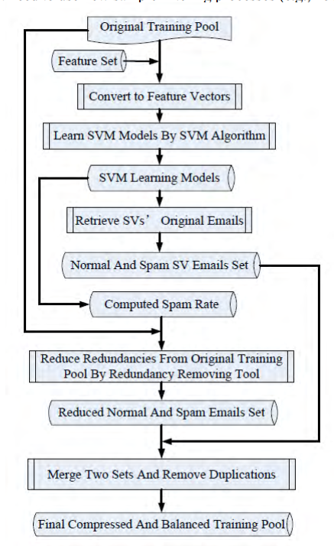
訓練數據集 處理過程

Slide 6
EXPERIMENTS AND RESULT
Training dataset size: 64,880
Testing dataset size: 280,904
Training dataset contain 5,416 normal mail and 59,464 spams.

Slide 7
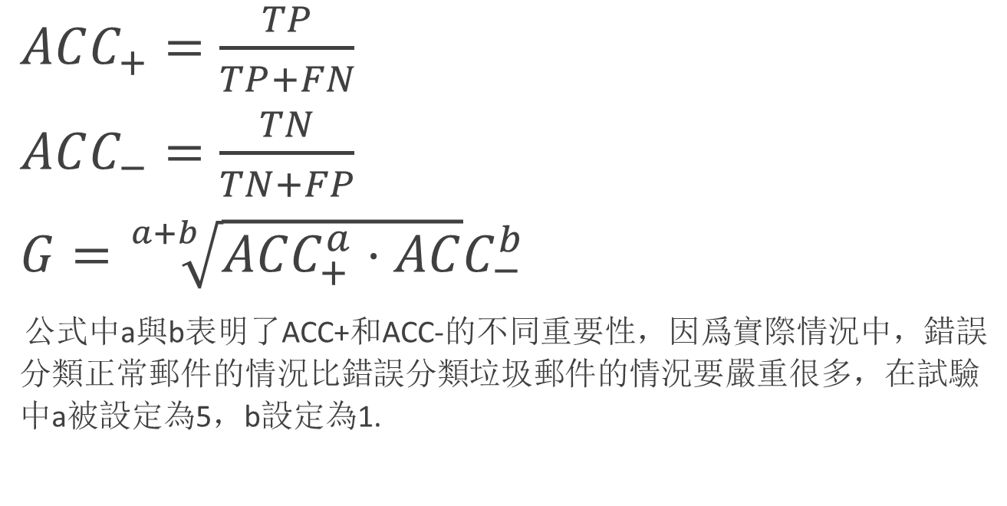
Performance Measure
$ACC_{+}=\frac{TP}{TP+FN}$
$ACC_{−}=\frac{TN}{TN+FP}$
$G=\sqrt[a+b]{ACC_{+}^{a}⋅AC}C_{−}^{b}$
公式中a與b表明了ACC+和ACC-的不同重要性，因爲實際情況中，錯誤分類正常郵件的情況比錯誤分類垃圾郵件的情況要嚴重很多，在試驗中a被設定為5，b設定為1.

Slide 8
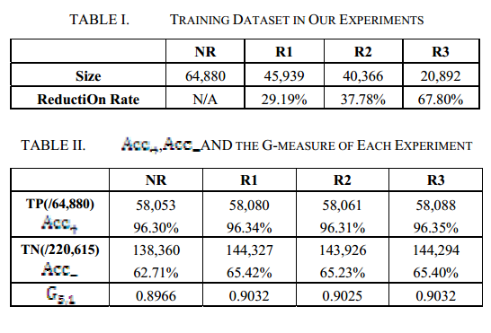
實驗結果
NR代表未經減少的數據集合

Slide 9
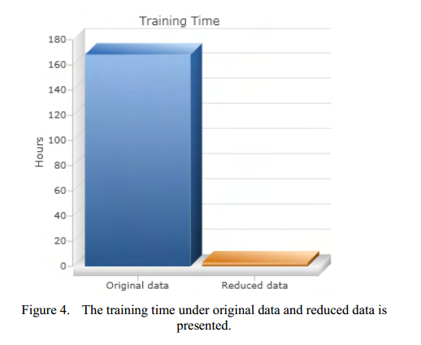
最終效果

